Slide 1
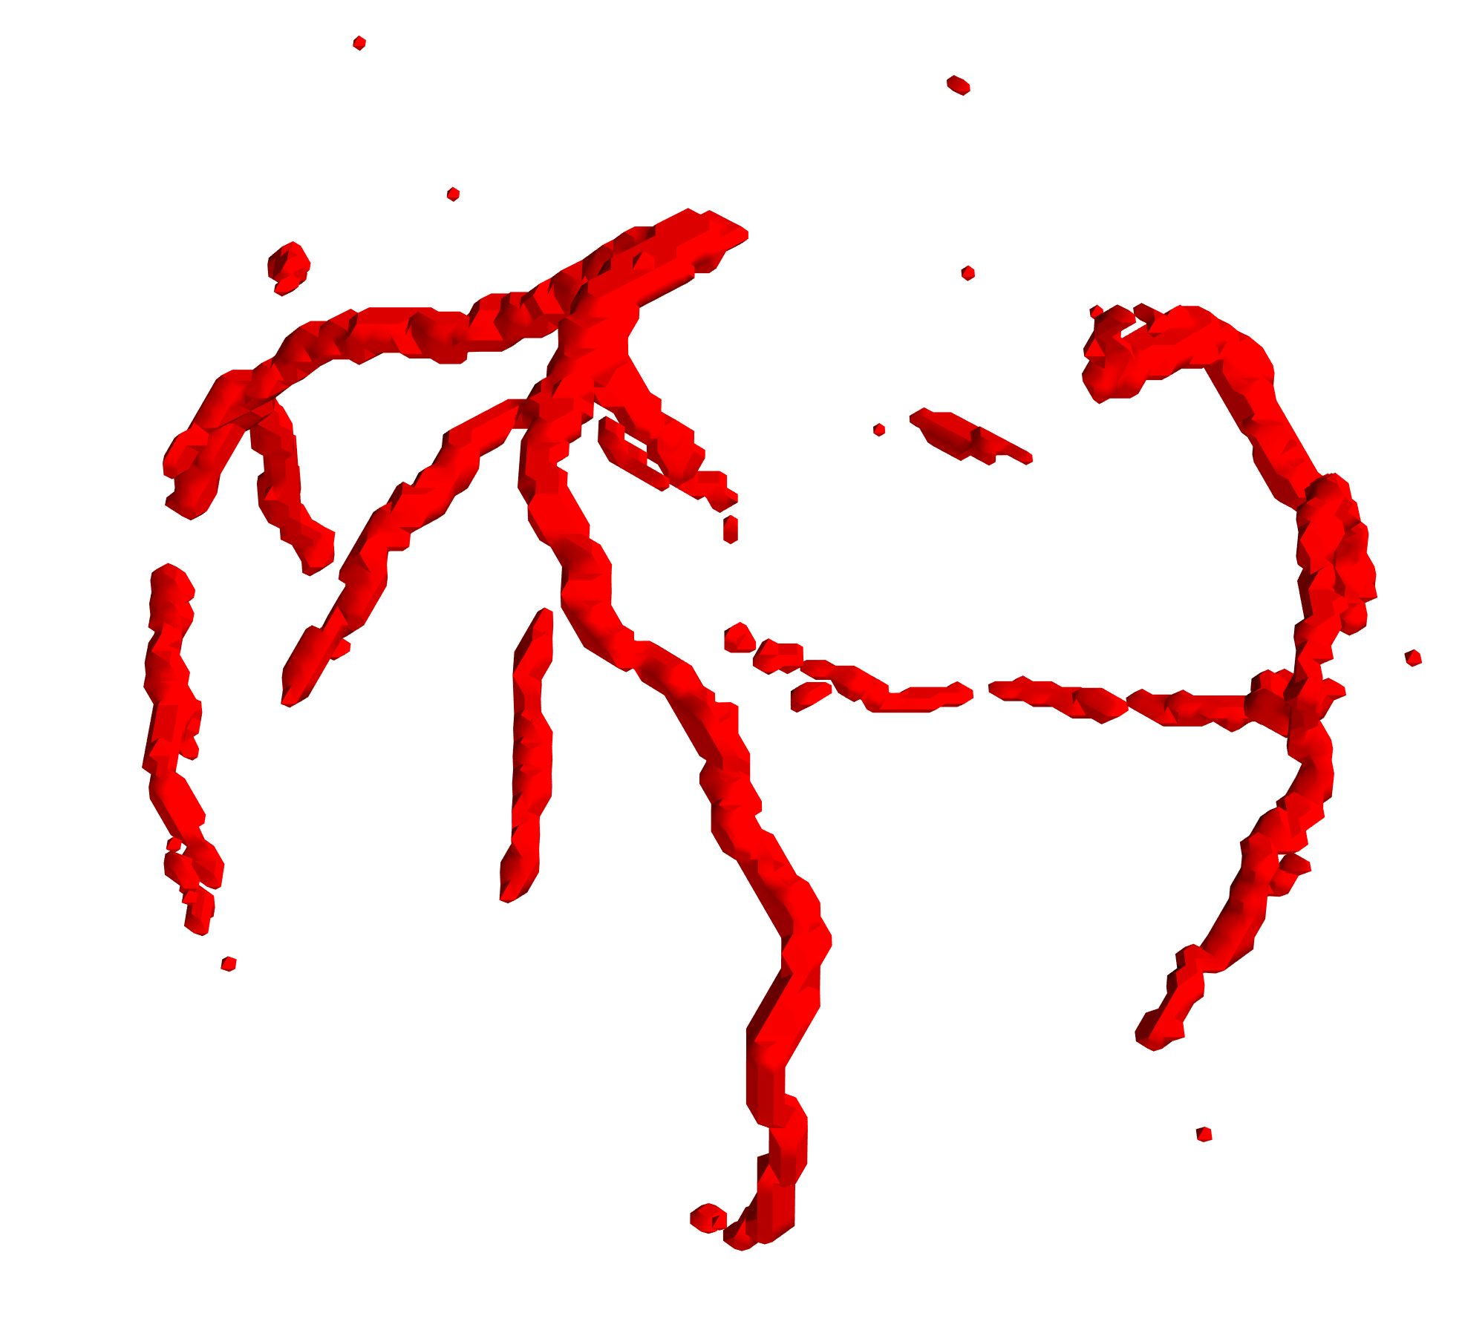
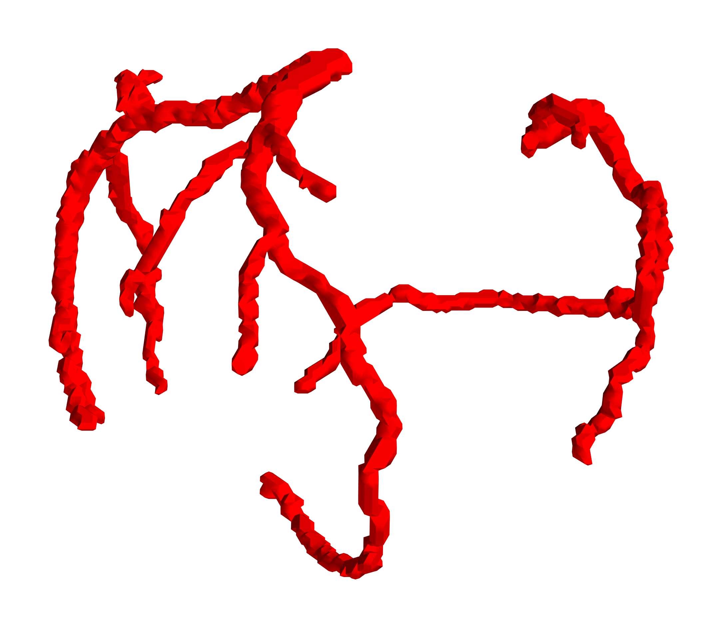
noise
discontinuity
Lost fragment
Label
Prediction

